Slide 1


WATER CONSERVATION • NORTH CAROLINA
North Carolina has funding to help communities conserve water.
One of the best opportunities is the Community Conservation Assistance Program (CCAP).
A cost-share funding opportunity for homeowners and communities
Notes:
Did you know North Carolina has funding available to help communities conserve water? One of the best opportunities is the Community Conservation Assistance Program (CCAP).

Slide 2
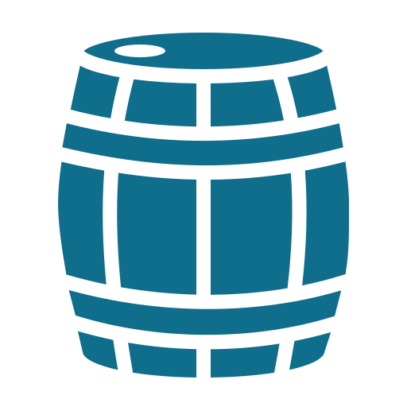
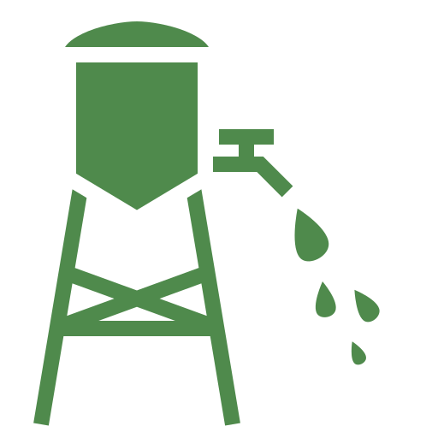
What's the difference?
Two ways to capture rainwater at home
Rain Barrel
Cistern
Holds 40–100 gallons
Holds 200–10,000+ gallons
Collects water from one downspout
Great for gardens and landscaping
Easy, low-cost DIY option
Can connect to multiple downspouts
Provides water during droughts
Ideal for irrigation and long-term conservation
Notes:
Rain barrels hold about 40–100 gallons, collect from one downspout, and are an easy, low-cost DIY option for gardens and landscaping. Cisterns store 200–10,000+ gallons, can connect to multiple downspouts, provide water during droughts, and are ideal for irrigation and long-term conservation.

Slide 3


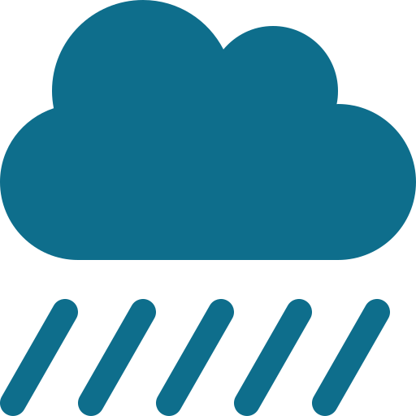
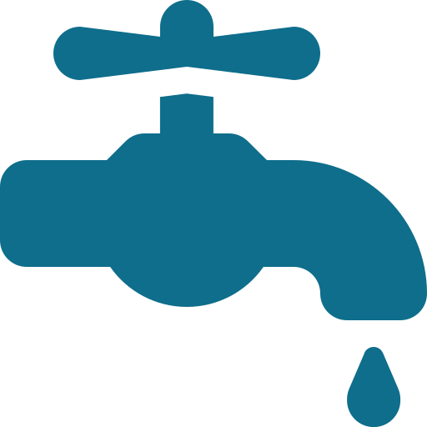
Why does it matter?
Rush into our streams
Every gallon of rainwater captured is a gallon that doesn't…
Contribute to flooding
Increase stormwater runoff
It's a win for homeowners and the environment.
Need to come from our drinking water supply
Notes:
Every gallon of rainwater captured is a gallon that doesn't rush into our streams, contribute to flooding, increase stormwater runoff, or need to come from our drinking water supply. It's a win for homeowners and the environment.

Slide 4

CCAP can help fund conservation projects.
ELIGIBLE PRACTICES MAY INCLUDE
Cisterns
UP TO
75%
Rain gardens
Permeable pavement
cost-share assistance
Depending on eligibility and available funding
Stormwater improvements
Other conservation practices
Notes:
CCAP can help fund conservation projects. Eligible practices may include cisterns, rain gardens, permeable pavement, stormwater improvements, and other conservation practices. Many projects can receive up to 75% cost-share assistance, depending on eligibility and available funding.

Slide 5


Johnston County has an opportunity.
TODAY
Reduce flooding
Johnston County does not currently have a homeowner rainwater harvesting incentive program.
Conserve water
THE OPPORTUNITY
Imagine a program that helps homeowners install rain barrels or cisterns — while protecting our community and our rivers.
Protect our rivers
Notes:
Currently, Johnston County does not have a homeowner rainwater harvesting incentive program. Imagine a program that helps homeowners install rain barrels or cisterns while reducing flooding, conserving water, and protecting our rivers.

Slide 6





This is the kind of conservation we should be pursuing.
By seeking available state and federal grants, Johnston County can invest in practical solutions that:
Protect natural resources
Conserve water
Help homeowners
Support agriculture
Improve water quality
Conservation isn't just about protecting what we have today — it's about preparing for tomorrow.
Notes:
This is the kind of conservation we should be pursuing. By seeking available state and federal grants, Johnston County can invest in practical solutions that protect natural resources, conserve water, help homeowners, support agriculture, and improve water quality. Conservation isn't just about protecting what we have today — it's about preparing for tomorrow.

